Slide 1
Cognitive Science for AI
What is intelligence?

Slide 2
The briefest of intros to Cognitive Science for AI
Cognitive Science is the study of intelligence - what it is, how it is appears and is implemented in nature, how to think about it. Also how to engineer it.
The main areas of Cognitive Science are Computer Science, Psychology, Linguistics, Anthropology/Sociology, Neuroscience, Artificial Intelligence, Philosophy
We’ll split these up (minus the CS/AI) into the broad categories of:
Biology
Psychology
Philosophy
All these overlap but it is easier to split into pieces
We’ll cover them very superficially and give some of the most basic ideas as a start
Just a sampling of elements that might encourage further study, ie don’t let this be the last time you see these things

Slide 3
Who/What is intelligent?
Humans?
Humans that can’t read?
Humans that can’t speak?
Blind and deaf?
Babies?
Apes?
Remembering number/position lists
Dogs? Cats? Sheep? Pigs?
Birds?
Crows Use Tools
Reptiles?
Alligator mom takes care of babies
Octopus?
Escaping jar
Insects? Spiders?
Sentient bees
C. Elegans?
302 neurons full connectome
Plants?
No neurons
Bacteria? Viruses?
Rocks?

Slide 4
Who/What is intelligent?
Rocks? Sand?
Silicon?
Thermostat?
Transistor?
Abacus?
Mechanical Adding Machine?
CPU?
Assembly Language?
Python?
Matrix Multiplication?
Binary Search?
Shortest Paths?
Database?
Logistic Regression?
Hill Climbing/Gradient Descent?
Decision Tree?
MinMax w/ Alpha-Beta Pruning? Deep Blue Chess?
Euclidean Theorem Prover? Automated Integration?
N-layer Neural Network?
Google Translate?
ChatGPT?

Slide 5
What is Intelligence?
General
Adaptability?
Learning/Memory?
Language?
Logical Thinking/Math/Science?
Understanding?
Consciousness?
Sentience?
Specific
Playing chess?
Remembering in order a shuffled deck of cards?
Recognizing a grade school friend after 40 years?
Solving an integral?
Folding a shirt?

Slide 6
Cognitive Science for AI
Biology

Slide 7
Neuroscience
Neurons
Brain Anatomy and Physiology
The Senses

Slide 8
Brain Size
Brain size in neurons
C. elegans (Roundworm/Nematode) 302
Fruit Fly 2.5t
Bee 170t
Rat 31m
Dog 627m
Horse 1.2b
Raven 1.2b
Chimp 7.4b
Human 16.3 b
Orca 43b
https://en.wikipedia.org/wiki/List_of_animals_by_number_of_neurons

Slide 9
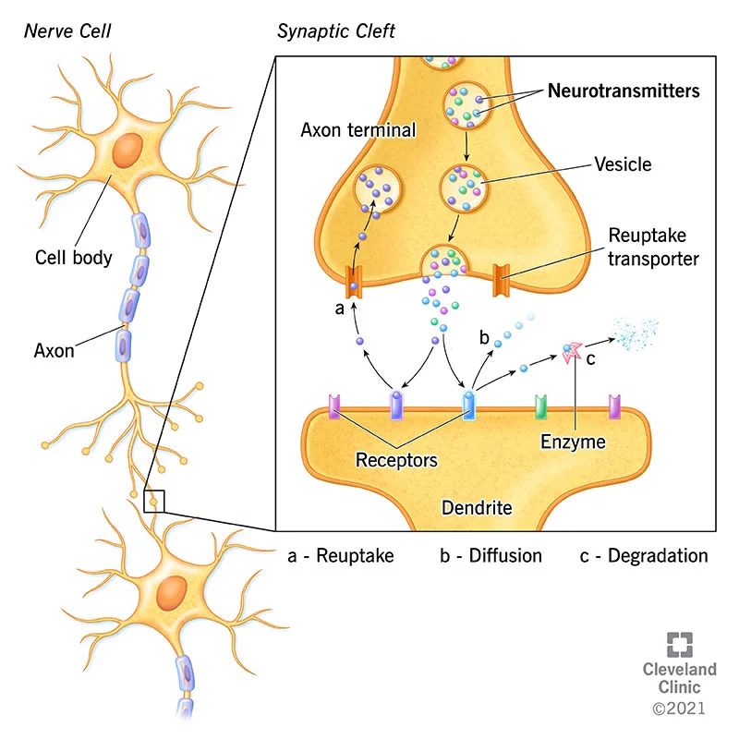
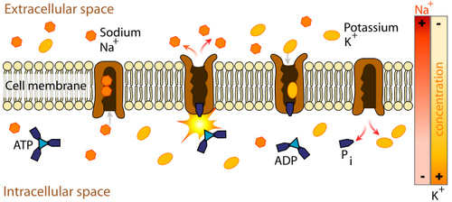
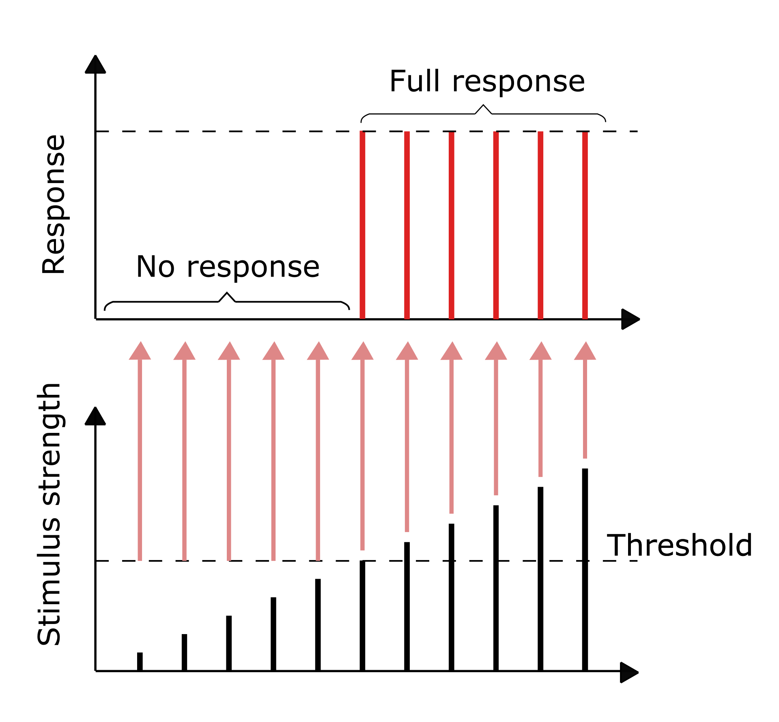
Neural Anatomy and Physiology
https://en.wikipedia.org/wiki/Neuron
https://flexbooks.ck12.org/cbook/cbse-biology-class-10/section/6.2/related/lesson/the-nerve-impulse-advanced-bio-adv/
https://my.clevelandclinic.org/health/articles/22513-neurotransmitters

Slide 10
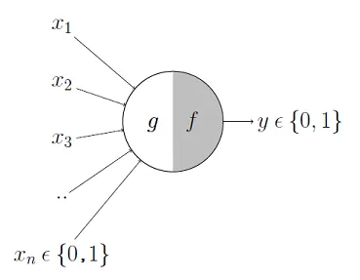
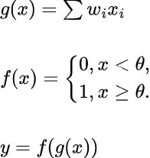
Elementary Neuron Model
McCulloch and Pitts 1943
Mathematical Model for a neuron

Slide 11
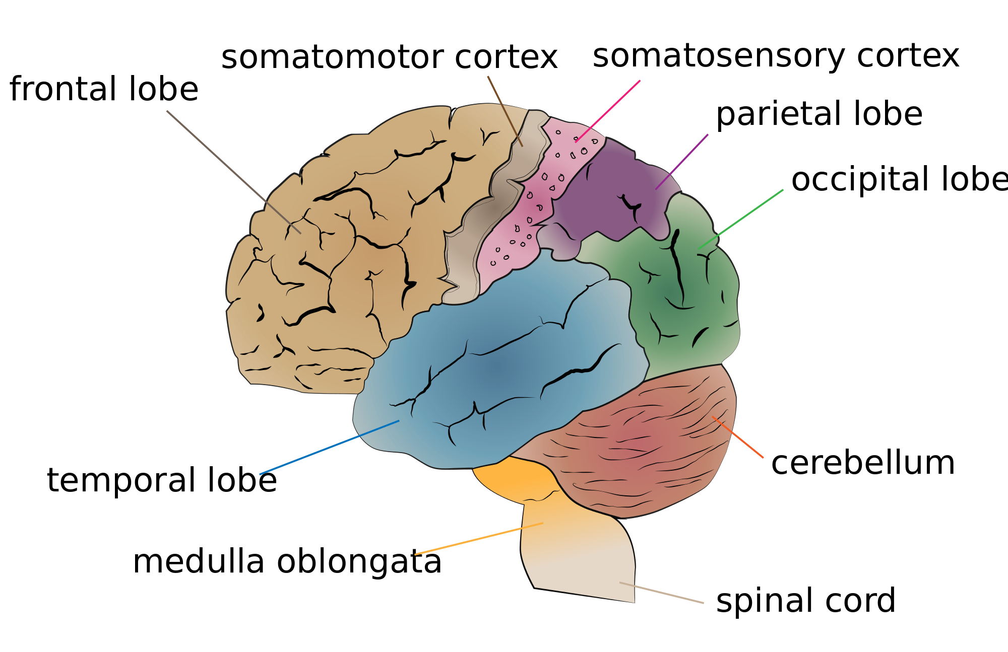
Gross Brain Anatomy
https://en.wikipedia.org/wiki/Perception#/media/File:Cerebrum_lobes.png

Slide 12
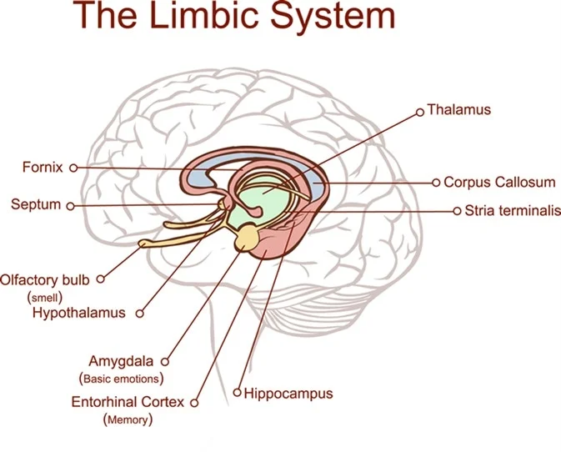
Limbic System
Hypothalamus
hunger, temp, fear
Hippocampus
consolidation of long term memories
spatial processing/memory
Amygdala
control of emotion, aggression
episodic-autobiographical memory
Thalamus - connections

Slide 13
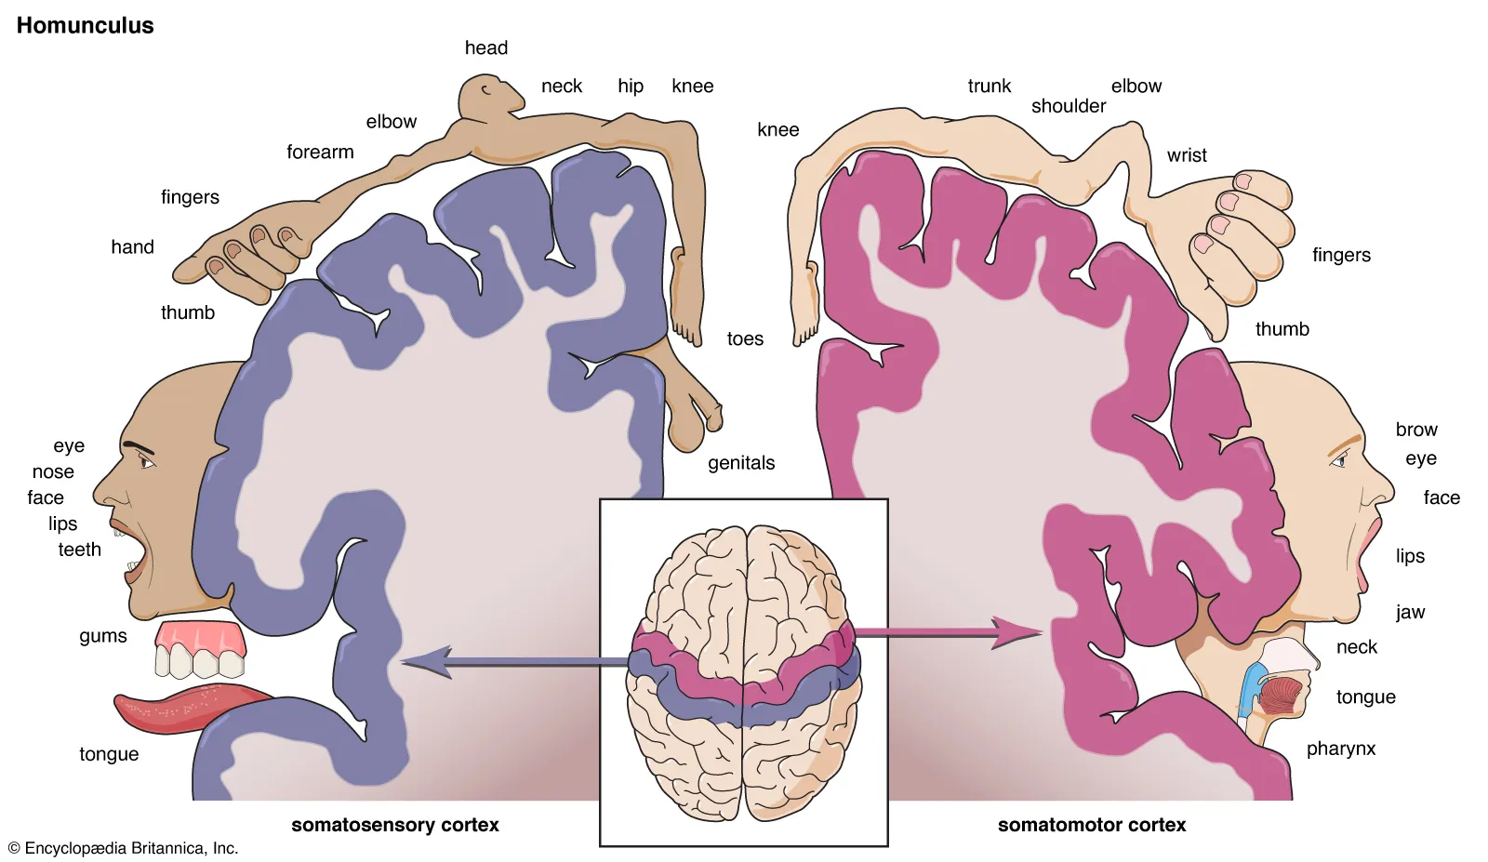
Sensory and Motor Homunculi

Slide 14
Senses
External stimuli
Vision
Light
Eye/Optic Nerve
Hearing
Sound
Inner Ear/Auditory Nerve
Touch
Pressure, Temperature, Pain
Skin Receptors, peripheral nerves
Smell/Taste
Chemical concentration
Chem Receptors, Olfactory Bulb
Internal Stimuli
Balance
Orientation/Movement
Semicircular canals/Auditory Nerve
Pain
Cell Destruction
Skin and Body
Proprioception
muscle tension/fatigue
Joints, muscles
Other: Hunger, Emotions, etc
Glucose, CO2outl, Hormones

Slide 15
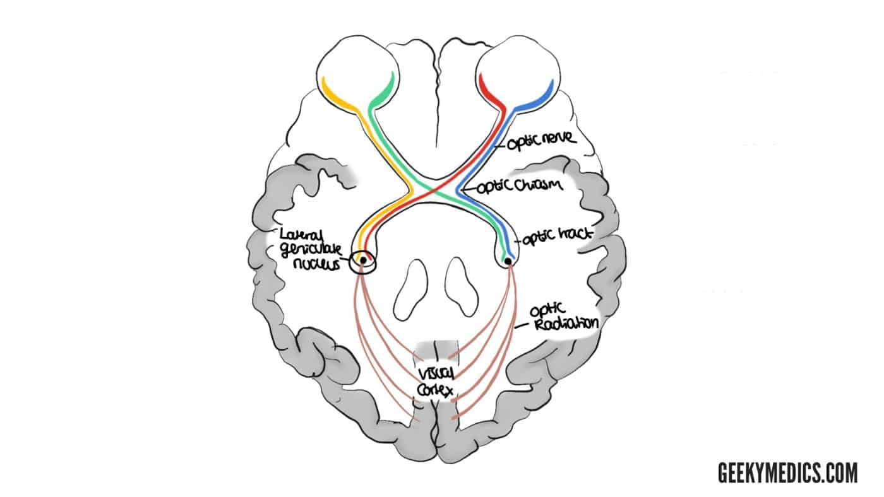
Visual Pathway
Left/Right Retinas: rods and cones
Optic Nerves to Optic Chiasm
Lateral Geniculate Nucleus (in Thalamus) movement, depth, R/G B/Y opponent process
Visual Cortex - Occipital Lobe
V1 - primary retinotopic, edge detection, gaze shift
V2-V6
Visual Association Cortex and further
Dorsal -> Parietal Lobe, Location, short term, ‘how’
Ventral-> Temporal Lobe, Object Identification, long term, ‘what’
To other lobes - eg Facial Recognition
https://geekymedics.com/visual-pathway-and-visual-field-defects/

Slide 16
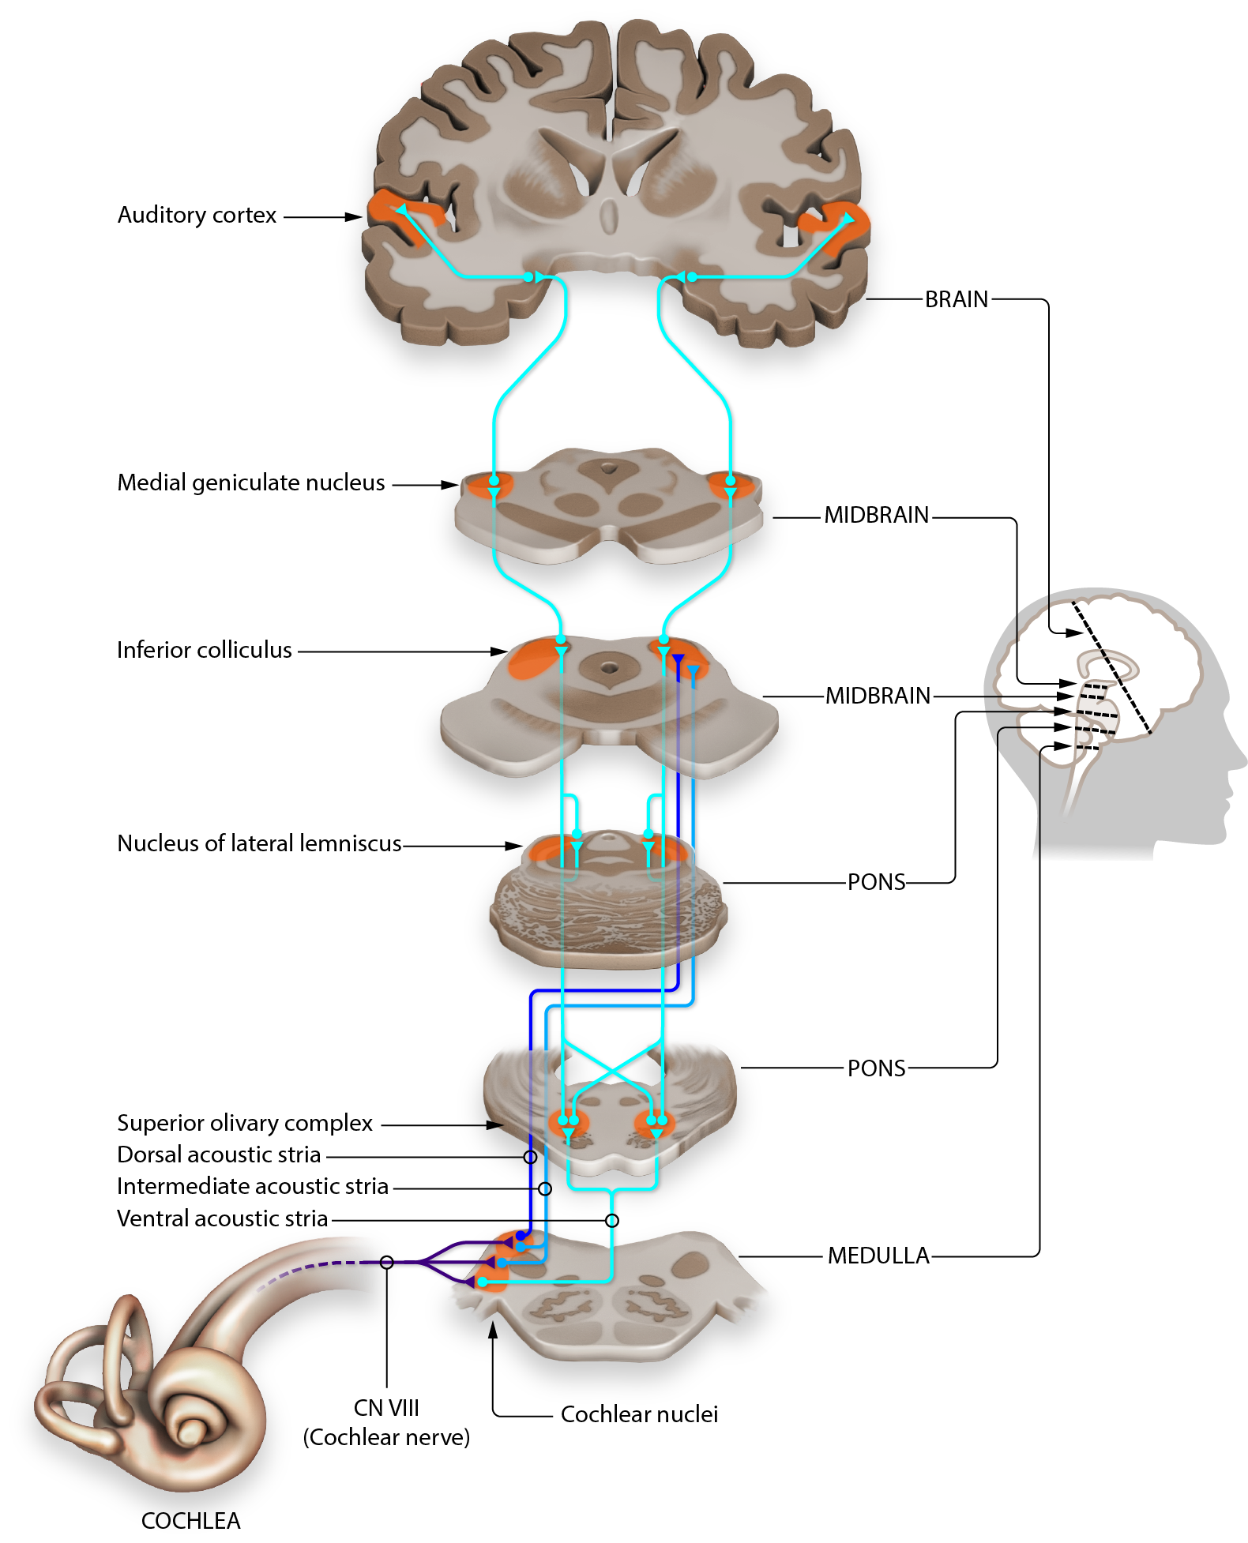
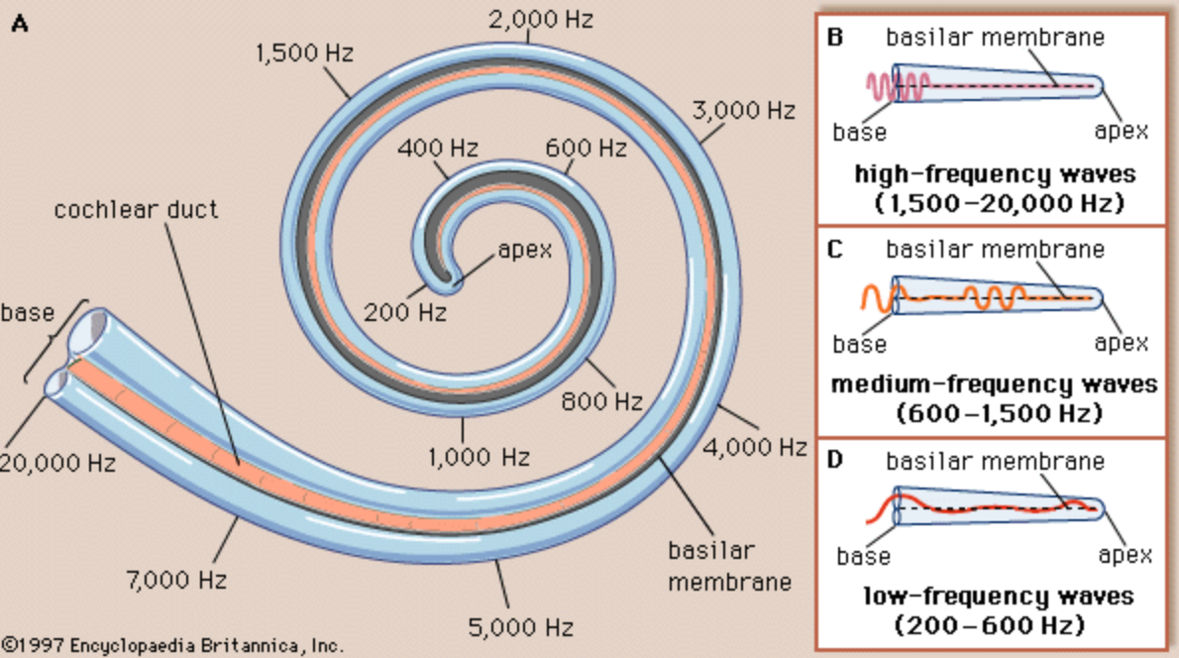
Auditory Pathway
Left/Right Cochlea: Frequency ‘piano keyboard’
Cochlear Nerves
Medulla -> Pons -> Inferior Colliculus -> Medial Geniculate Nucleus
Auditory Cortex - temporal lobe
Tonotopic - mapping to keyboard
Broca’s Area - speech recognition
Wernicke’s Area - speech production
https://pressbooks.umn.edu/sensationandperception/chapter/auditory-pathways-to-the-brain-draft/
https://www.britannica.com/science/inner-ear#/media/1/288499/18100

Slide 17
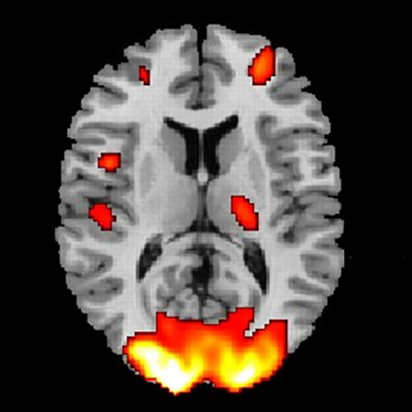
Neuroscience: Complications
Left/right asymmetry
Inhibition of action
Interconnections - large and small scale
Reductionism vs Holism
Every location one function - modular machine parts
But function covered by multiple/unspecified areas
And effects of injury can be reduced/overcome
Comparative anatomy
Mammals - all levels of anatomy same or very close
Birds - neurons same, gross anatomy anaolgous
Cephalopods - neurons similar, very loose analogies
How do we know all this?
Behavior of people after accidents/strokes/surgery and comparing with autopsy
Behavior during brain surgery
New cryo+imaging techniques, fMRI, MEG/SQUIDs
Mostly primate/rodent experimentation
https://www.brainline.org/slideshow/brain-imaging-what-are-different-types

Slide 18
Lessons from Biology/Neuroscience
The brain is not a computer
there is no CPU, no monolithic memory bank
No software, no separable ‘program’ - it’s all hardware
The network of neurons is not a (artificial) Neural Network
The eye is not a snapshot or movie camera
The senses are fallible - the brain fills in gaps, makes assumptions
There’s a lot we just don’t know (we don’t know enough to simulate)

Slide 19
Cognitive Science for AI
Psychology:
Memory and Learning

Slide 20
Cognitive Psychology
Memory
Learning
Vision
Language
Reasoning

Slide 21
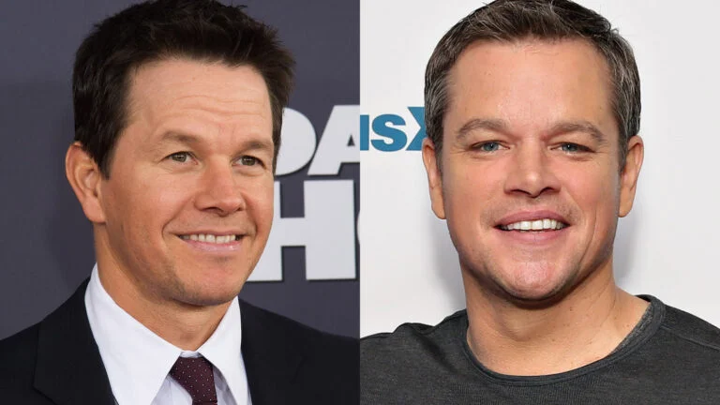
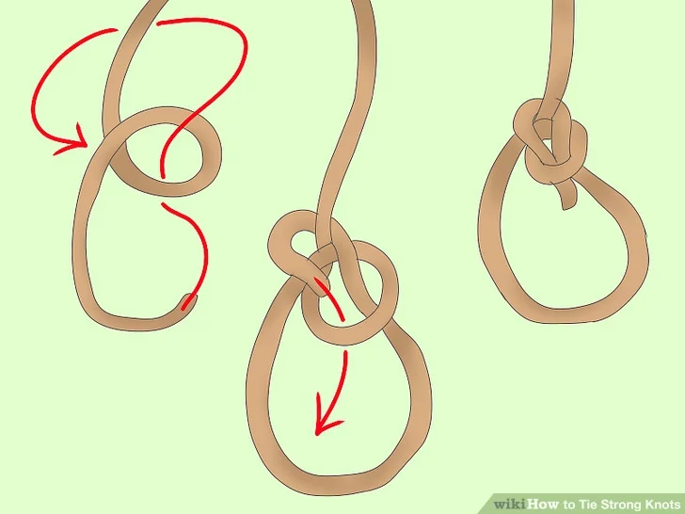

Memory
Semantic - facts, word meanings
Perceptual - faces, voices, places
Procedural - motor skills, directions
Episodic - time/place events
PHOTO: LUCASFILM

Slide 22
Memorizing Sequences
7 0 3 2 1 2 8 5 7

Slide 23
Memorizing Sequences
Seven plus or minus two - number of objects in short term memory
Repetition
Primacy
Recency
Context

Slide 24
Memorizing Sequences
7 0 3 2 1 2 8 5 7
Seven plus or minus two - number of objects in short term memory
Repetition - repeat repeat repeat
Primacy - earlier in the list are repeated more often
Recency - later in the list easier to access and ‘overwrite’ earlier ones
Context - nothing is in a vacuum, you learn in a situation
Memorizing sequences of numbers is not a ‘natural’ (ecological) task

Slide 25
Information Processing Model
Sensory Memory (iconic/echoic)
Working Memory (STM - short term memory)
Long Term Memory (LTM)
rehearsal
senses
attention
encoding
Sensory
STM
LTM
retrieval
forgotten
forgotten
forgotten
Atkinson-Shifrin model

Slide 26
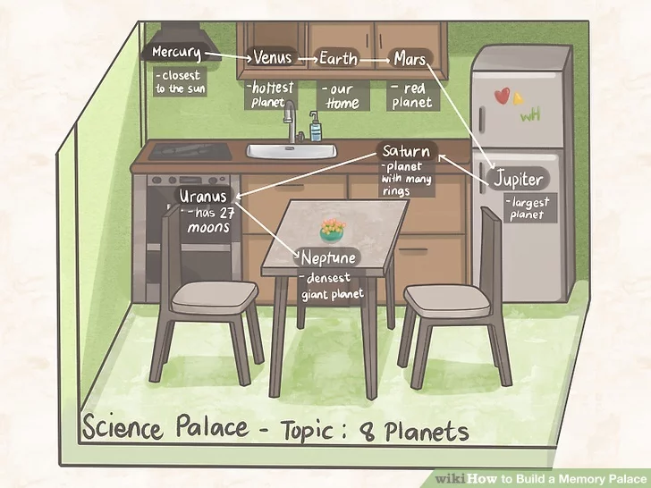
Memory Techniques
Chunking
703 = Northern Virginia
212 = DC
857 = Boston
7 0 3 2 1 2 8 5 7
7 0 3-2 1 2-8 5 7 = NVa DC Boston
The “Memory Palace”
Use a “natural” memory sequence to string along an arbitrary one
https://www.wikihow.com/Build-a-Memory-Palace

Slide 27
Learning
Habituation - repetition reduces response strength
Classical Conditioning - Pavlov’s salivating dog
Operant Conditioning - Skinner, reinforcement schedule, reward and punishment
‘Insight’ Learning

Slide 28
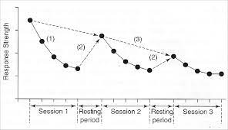
Habituation
Given an existing stimulus and response
Repetition of stimulus reduces response strength
Simplest, most universal form of learning
Works at many levels
Full organism - fear
Specific behaviors -
Senses, individual neurons - trigger fatigue
Biochemical response - in drug addiction

Slide 29
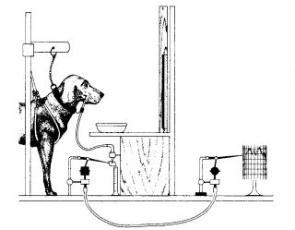
Classical Conditioning
Pavlov’s dog
Food causes dog to salivate
Ring bell every time dog presented with food
Eventually ringing bell causes dog to salivate
Associative Learning
Unconditioned Stimulus US - sight/smell of food
Unconditioned Response UR - salivation
Reflex/built-in biology
Associated US and UR
Conditioned Stimulus CS - bell ringing
arbitrary
https://www.psychologytoday.com/intl/blog/dont-delay/201310/how-not-be-pavlovs-dog

Slide 30
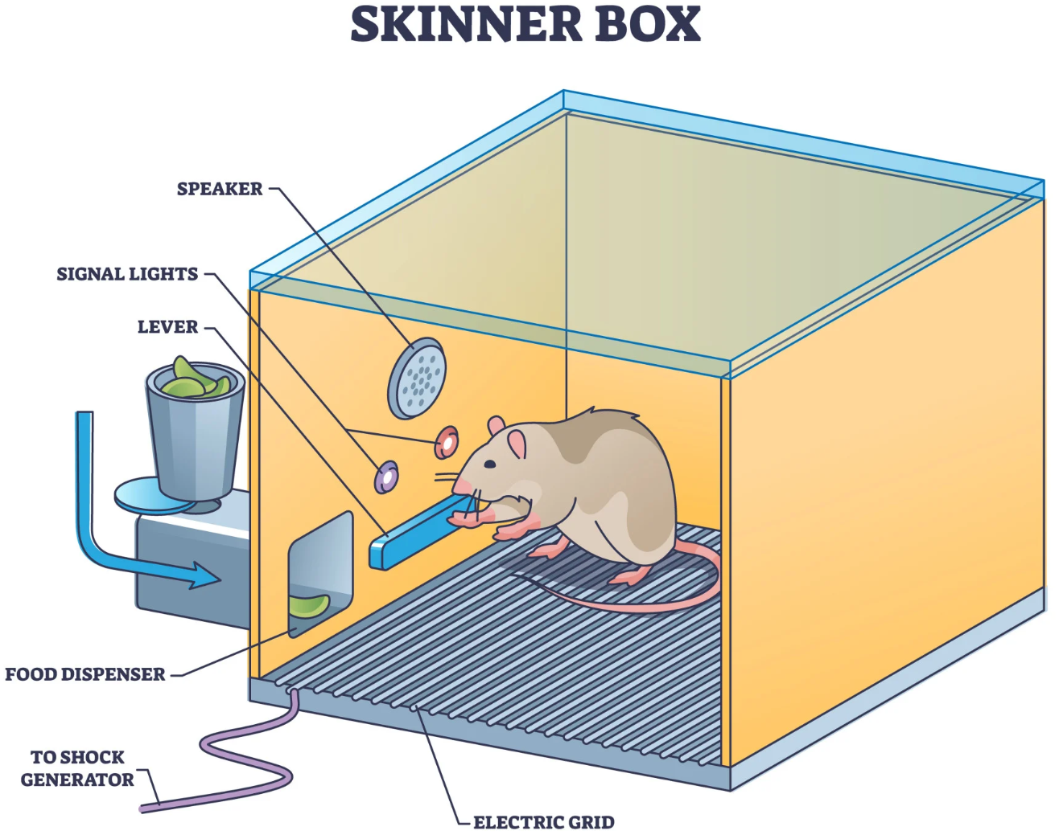
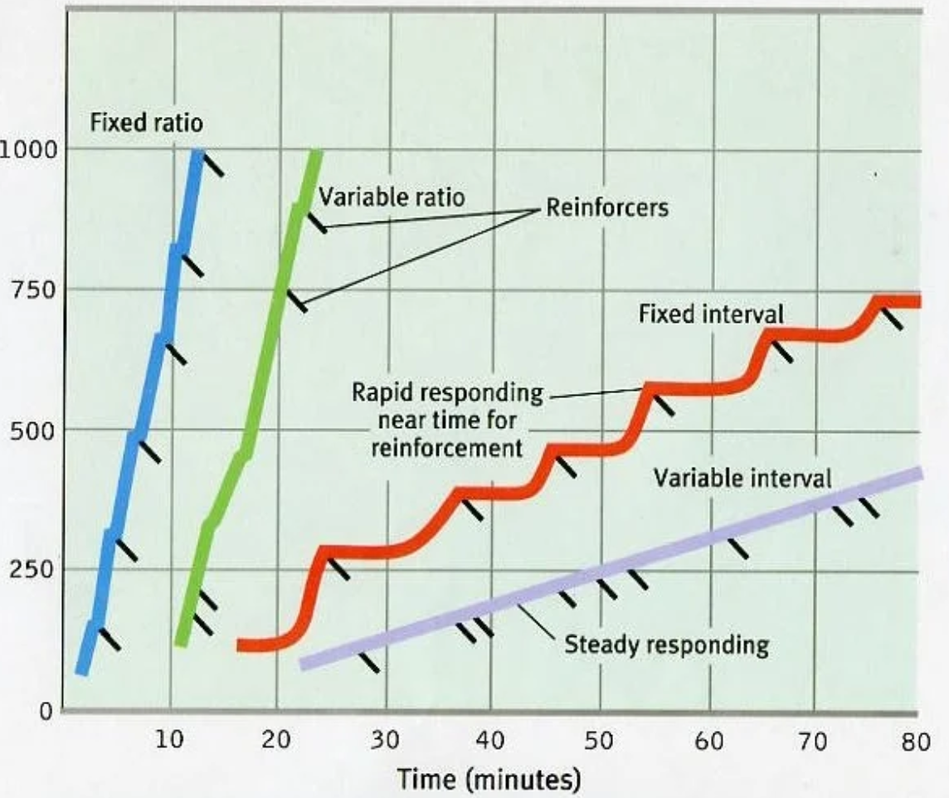
Operant Conditioning
Training
treat for a desired action
shock for an undesired action
Reinforcement: reward and punishment
positive and negative
Schedules
Fixed and variable interval (time)
Fixed and variable ratio (number of instances)
Factors
Extinction - how long til response unlearned
Satiation - enough reinforcement may satisfy motivation
Immediacy - how soon reinforcement occurs after action
Consistency - learning slower with longer spacing
Strength - stronger stimulus makes learning faster
Best?
variable ratio
mitigates extinction
Worst?
variable interval
irrelevant connection
Examples: circus animals, slot machines, flashcards
https://www.simplypsychology.org/schedules-of-reinforcement.html

Slide 31
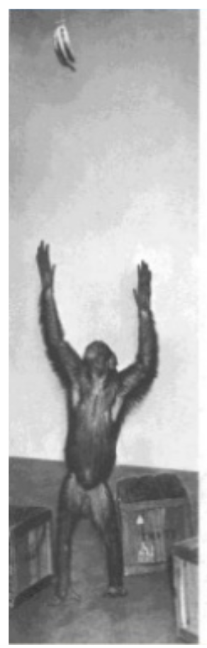
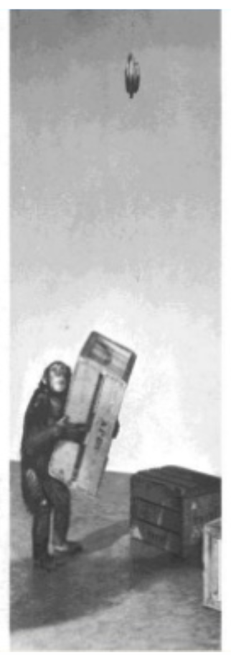
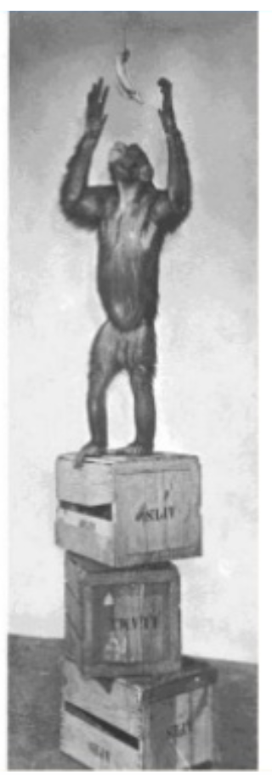
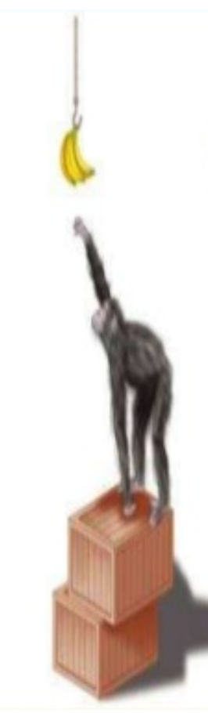
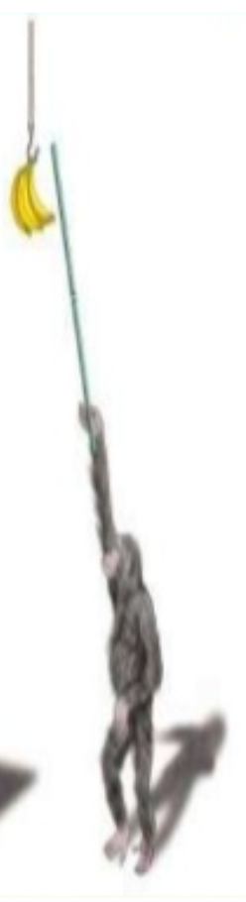
Insight Learning
http://srividyagurugubilly.blogspot.com/2019/10/psychology-of-teaching-and-learning.html

Slide 32
Lessons from Learning/Memory
There’s no one location for memory. In some sense it is everywhere.
Memory degrades over time
Memory is fallible
There’s a lot we just don’t know

Slide 33
Cognitive Science for AI
Vision

Slide 34
Vision
Theory of Color - RGB/CYKZ/HSB, Opponent Process
Edge/Feature Detection - Hubel and Wiesel
Object Recognition, Tracking, Surface Reconstruction
3D representation
Optical Illusions - shows where mechanisms aren’t perfect
Special downstream processing
Dorsal Stream - movement, attention, tracking V2,V5/MT,V6/DM
Ventral Stream - V4, form and object recognition
Facial recognition
Fusiform Face Area (FFA): inferior temporal, fusiform gyrus
Buildings and places
Parahippocampal Place Area (PPA): medial temporal lobe
Reading

Slide 35
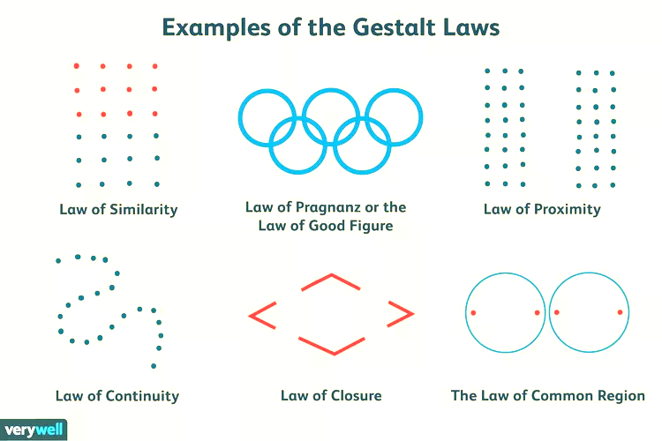


https://www.verywellmind.com/gestalt-laws-of-perceptual-organization-2795835

Slide 36
Cognitive Science for AI
Language

Slide 37
Language
Complex sound waves converted to meaning
Form
Phonology - language specific perception and production
Morphology/Syntax - how to put words together
Meaning
Lexicon - word meaning, associations
Semantics - the sentence, logic, relations
Pragmatics - what you really mean in context
Discourse Analysis - mental model, pronoun resolution

Slide 38
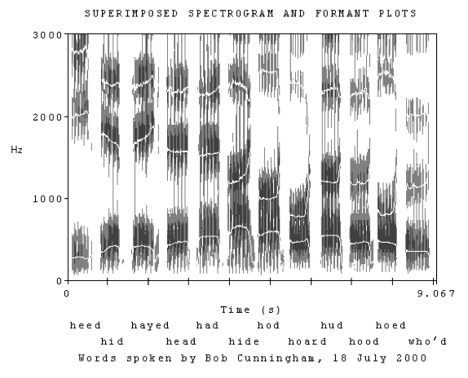
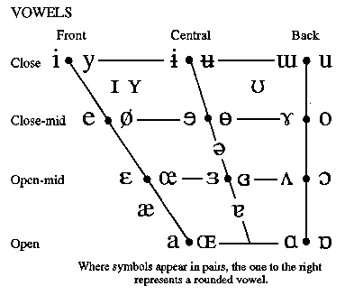
Form: Phonology
IPA - International Phonetic Alphabet
Formant bands for vowels
https://home.cc.umanitoba.ca/~krussll/138/sec5/vowels1.htm

Slide 39
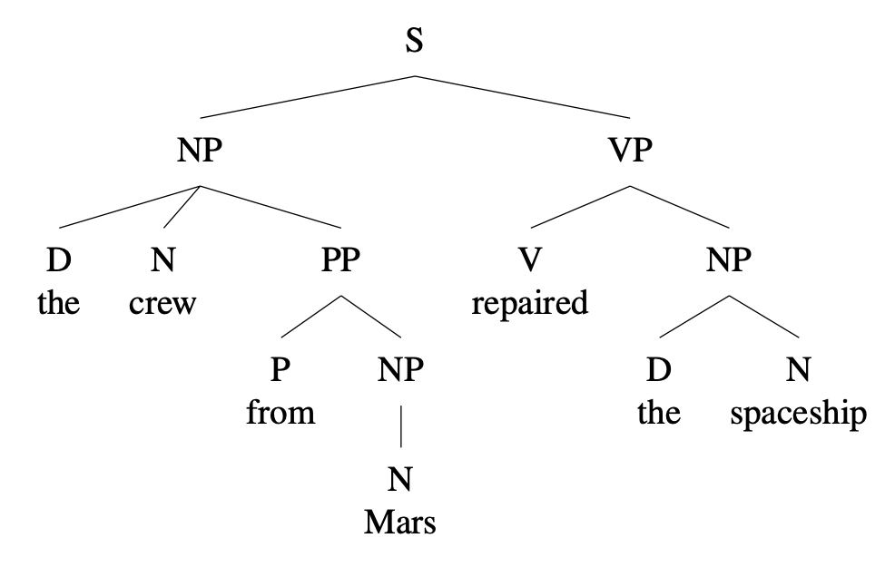
Syntax/Morphology
Parse Tree Grammars
S -> NP VP
NP -> (D) N (PP)
PP -> Prep NP
D -> the | this | that | a | an
N -> crew | Mars | spaceship
Prep -> of | in | from
VP -> V NP
V -> repair | repairs | repaired
singular plural
1st tengo tenemos
2nd tienes tienen
3rd tiene tienen
Inflection - to have
https://ecampusontario.pressbooks.pub/essentialsoflinguistics2/chapter/from-constituency-to-tree-diagrams/

Slide 40
Some Language Types
English He saw a cat in the hat.
French Il a vu un chat dans le chapeau.
He has seen a cat in the hat.
Latin Vidit felem in petasum.
He-saw cat-obj in hat.
Irish Chonaic sé cat sa hata.
Saw he cat in hat.
Hindi उसने टोपी में एक बिल्ली देखी।
He (the) hat in a cat see.
Russian видел кошку в шляпе.
He-saw cat in hat.
Swahili Aliona paka kwenye kofia.
He-past-see cat in hat.
Chinese 他看到一只猫戴着帽子。
He see a cat in hat (done).
Word Order
SVO - English Chinese Russian French Swahili
SOV - Hindi
VSO - Irish
Pronoun-drop
Yes - Russian Latin Swahili
No - English French Irish
Verb formation
Inflected - Latin Russian Hindi Irish French
Agglutinative - Swahili
Analytic - English Chinese
Articles
Indef and Def - English French
Indef - Hindi
None - Latin Chinese Russian Swahili Irish

Slide 41
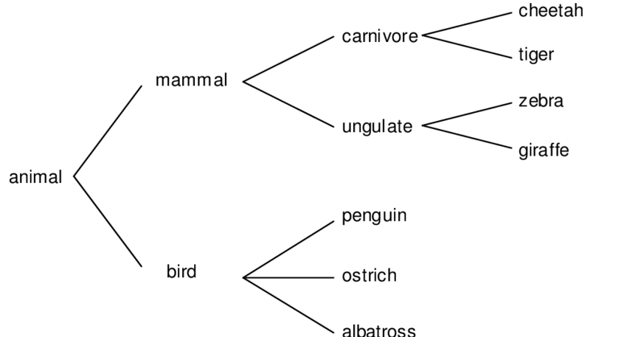
Lexicon - the set of words in a language
Semantic features
Queen = -male | +ruler | +face-card
Jack = +male | -ruler | +face-card
Modeled with a bit vector
Prototype
Central concept w fuzzy extent
Exemplars
List of examples
Taxonomy - simple relation
Synonyms, Antonyms, Hypernyms
Ontology - Concepts with relations
WordNet English taxonomy
Entity-Relationship diagram, Frames

Slide 42
Semantics
“There is not a person in this courtroom who has never told a lie, who has never done an immoral thing, and there is no man living who has never looked upon a woman without desire.” Atticus Finch in ‘To Kill a Mockingbird’
What does this mean?
The logical, primary meaning in first order logic
¬ ∃ x [ P(x) ^ C(x) -> ¬L(x) ^ ¬I(x) ] ^
¬ ∃ x [M(x) ^Liv(x) -> ¬ Look(x, y) ^ Des(x,y)]
The intention, what it is trying to get you to think
Emotional consequences

Slide 43
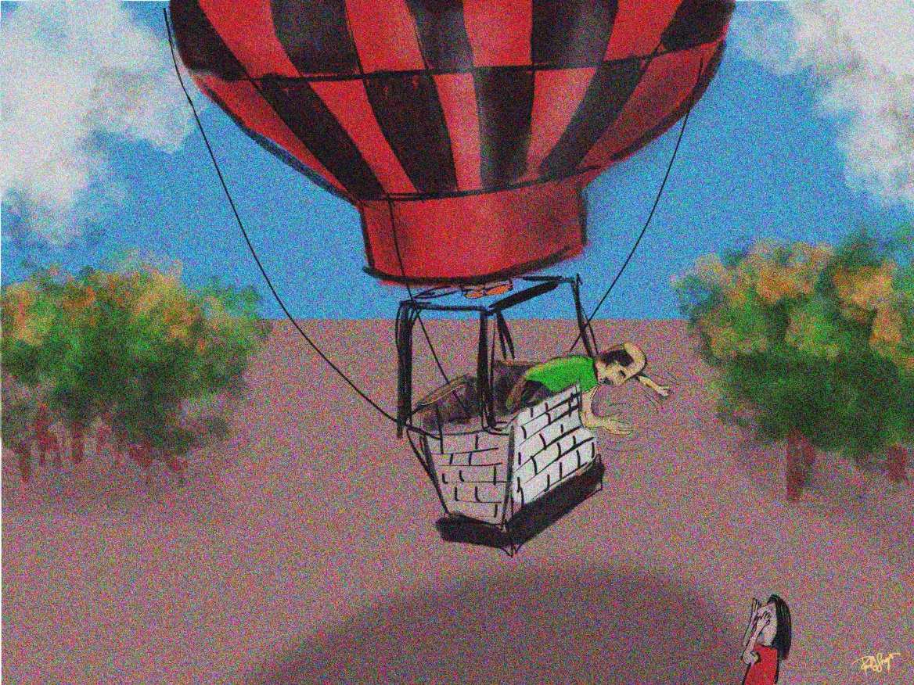
Pragmatics
Context and intention
Common sense, sociolinguistics
Implicature
what you would have said
“Do you know what time it is?”
“It’s 5 o’clock”
“Yes.”
“OMG, I’m late already”
https://portfoliolongo.com/2014/10/11/the-balloonist-and-the-hiker-an-evaluator-joke/

Slide 44
Example: Grice’s maxims of conversation
Maxim of quantity - Say what is needed but no more
Maxim of quality - Say the truth
Do not say what you believe is false
Do not say that for which you lack adequate evidence
Maxim of relevance - Be relevant.
Omit any irrelevant information
Maxim of manner - Be clear
Avoid obscurity
Avoid ambiguity
Be orderly

Slide 45
Discourse Analysis
“It is a truth universally acknowledged, that a single man in possession of a good fortune must be in want of a wife. However little known the feelings or views of such a man may be on his first entering a neighbourhood, this truth is so well fixed in the minds of the surrounding families, that he is considered as the rightful property of some one or other of their daughters.” Jane Austen ‘Pride and Prejudice’
What is going on? Who is referring to what? How does the second sentence explain or elaborate on the first? What are the properties of this way of communicating?

Slide 46
Lessons from Linguistics
Form is arbitrary, it doesn’t have to be this way
Every language is learnable by 3-5 yr olds - poverty of the stimulus
Translation is hard, not word for word, ‘You just don’t say it that way’
Translation is always possible - you can express the same idea in any language
Words are not concepts
but how we know about concepts is through words
Language is not writing
but mostly what we have is (disembodied) text
Most words have more than one meaning
Most utterances are not literal, meanings drift, many words started off as metaphors
Use vs mention - quotes hide meaning, but meaning leaks through
Human language is both biological and cultural - necessary features for our speech in mouth/throat/lungs, ears/brain, (but sign language!), and other animals have lots of linguistic potential, but we learn vocab and syntax and sounds from others

Slide 47
Cognitive Science for AI
Reasoning

Slide 48
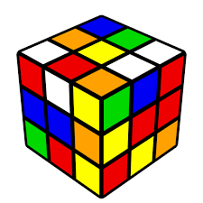
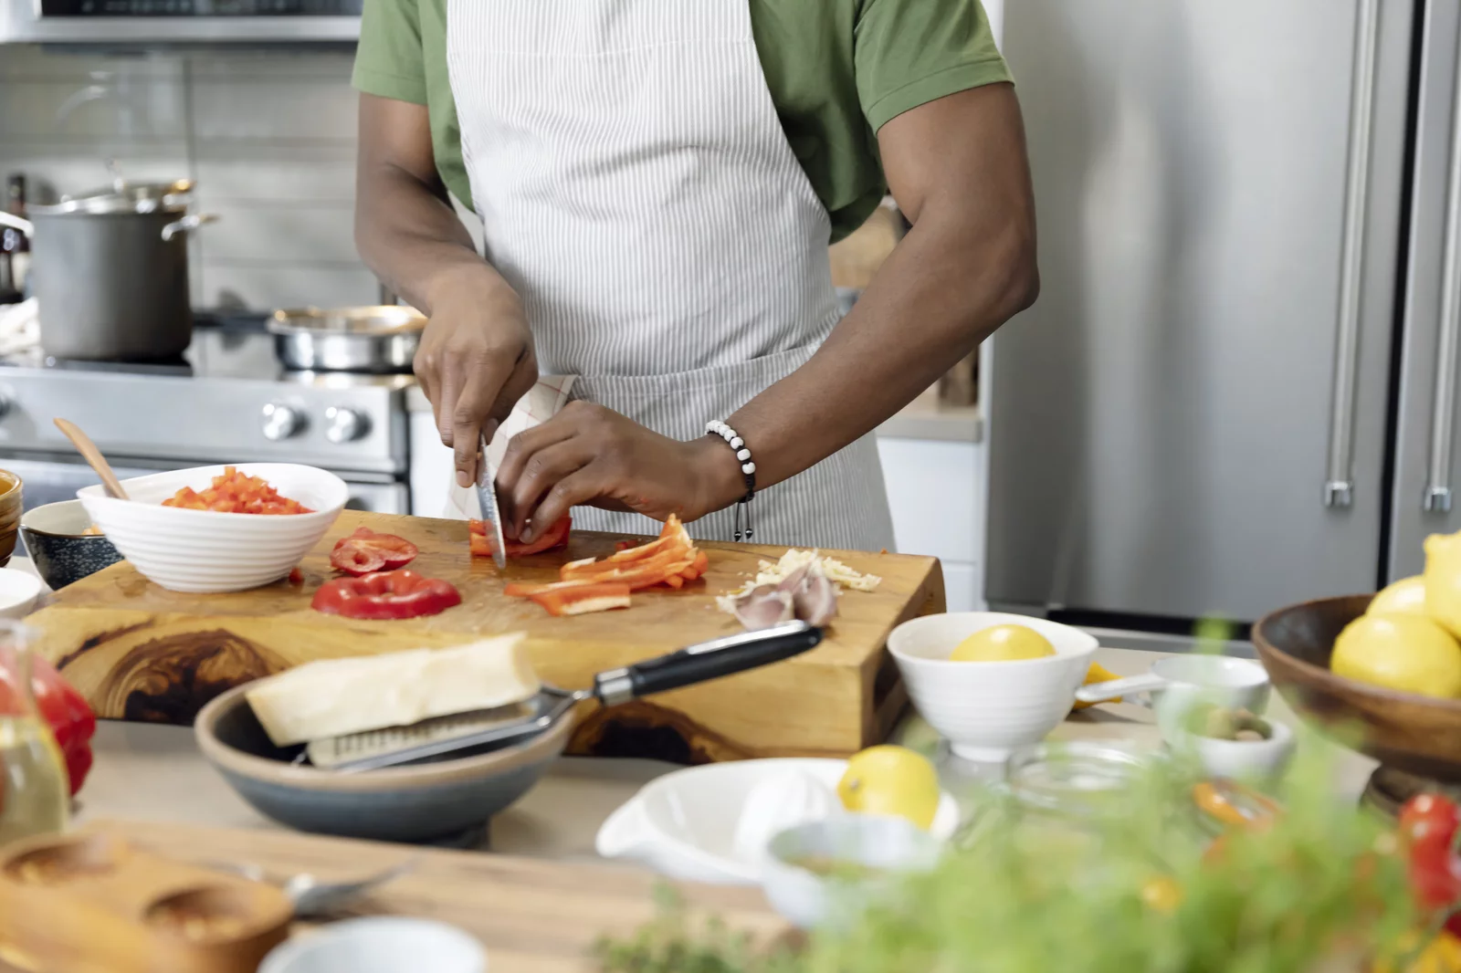

Reasoning and Problem Solving
https://www.npr.org/2023/01/27/1152155481/meal-prep-made-easy
https://www.officeforstudents.org.uk/news-blog-and-events/blog/freedom-to-question-challenge-and-debate/
https://en.wikipedia.org/wiki/Optimal_solutions_for_the_Rubik%27s_Cube

Slide 49
Rational Thought
Logic - propositional and first-order calculus
Probabilistic thinking - updating with Bayes
System 1 vs System 2
Fast - intuition, unconscious, probabilistic
Slow - deliberative, ‘rational’, rule based

Slide 50
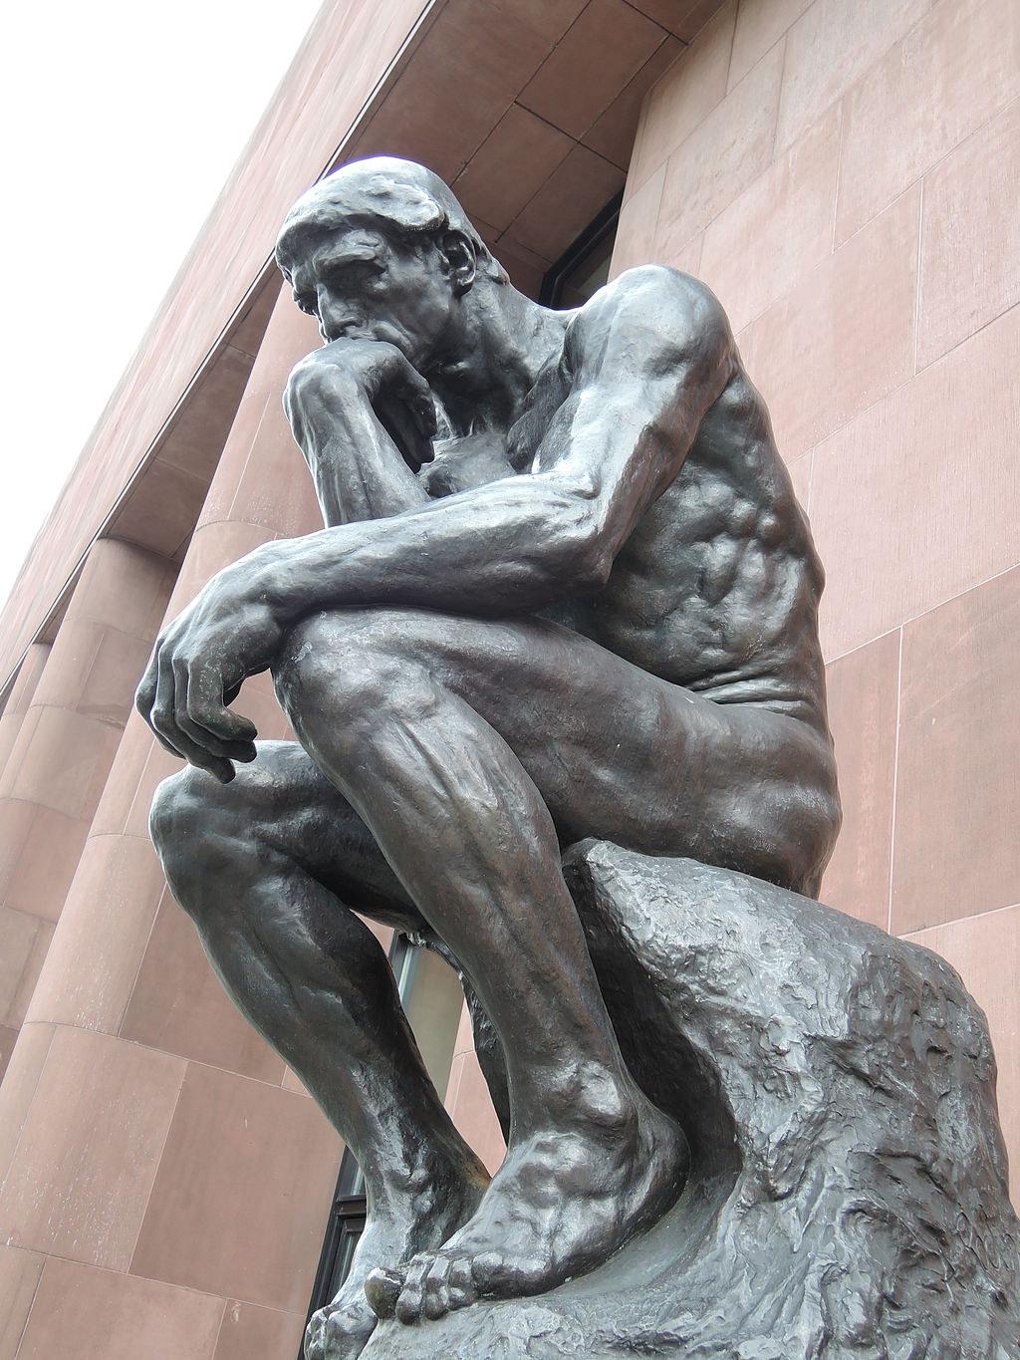
Thinking
Internal process - stream of consciousness
Step by step logical manipulations
Symbolic monologue
Nonsymbolic sequence of feelings/images
Counterfactuals, Hypotheticals
Awareness, Metacognition
Thinking about thoughts = Introspection
Theory of Mind
Mirror Test
Prisoner’s Dilemma
Rock Paper Scissors
https://en.wikipedia.org/wiki/Philosophy#/media/File:Le_Penseur_by_Rodin_(Kunsthalle_Bielefeld)_2014-04-10.JPG

Slide 51
Cognitive Biases
Ways in which thought is off from ‘rational’ (logic and evidence)
‘Linda is a bank teller’ vs ‘Linda is a bank teller and a feminist’
Overgeneralization - similar items alike in other features
Priming, Anchoring - pattern on first items seen
Recency - pattern on most recent data
Confirmation Bias - accepting data that confirms hypothesis, ignoring contradicting data, cherry picking
Motivated reasoning - justifying desired ends through selective reasoning
Emotional reasoning - appeal to authority/force/numbers/association
Apophenia
finding a pattern where none exists
assuming agency where none exists

Slide 52
Intelligence
Kinds of Intelligence
Logical-mathematical - abstract, symbolic - mathematician or programmer
Linguistic - words, languages, debate - lawyer or translator
Spatial - 3d representation - artist or architect
Bodily-kinesthetic - control of body - sports or crafts
Interpersonal - intentions and emotions - psychiatrist or manager
Naturalist - classifying natural phenomena
Measuring Intelligence
g - general measure of intelligence
IQ tests: “standardized test taking ability” - Math and Verbal
Clinical tests: MoCA - Montreal Cognitive Assessment

Slide 53
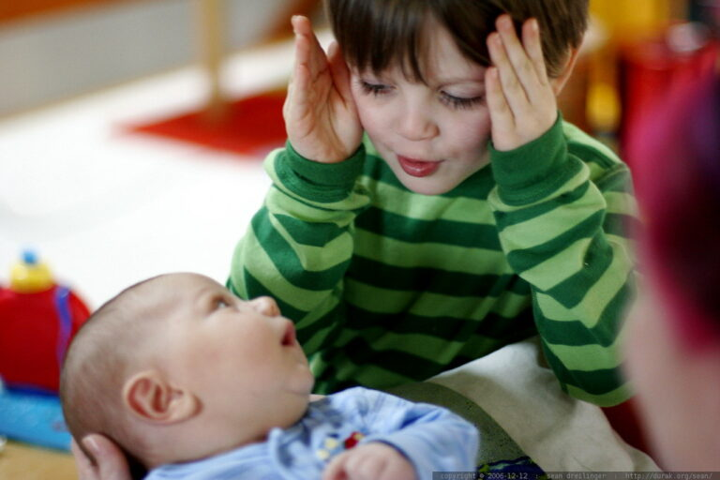
Child Development
From “blooming, buzzing confusion” to “Stephen Hawking”
Language development
Mean length of utterance
Piaget’s stages
Sensorimotor 0-2
Object Concept
Pre-operational 2-7
Conservation, language
Concrete 7-11
Inductive logic
Formal 11-
Video (1m) Object Permanance
Video (2m) Conservation number, volume
Video (1:30m) Point of View
“peek-a-boo – _MG_6709” by sean dreilinger.

Slide 54
Culture
All human societies do all of the following. Other animals do not (mostly).
Tech - shelter, fire, tools, clothing
Food - cooperative hunting food planning (shepherding, farming), cooking, table manners, taboos
Society - kinship, status/hierarchy, property, marriage, ethics, law
Customs - magic, religion, rites of passage, play, music, stories, humor
What about numbers? writing?

Slide 55
Lessons from Cognition
There’s more to intelligence than book learning - not a database of facts
There’s more to intelligence than reason - not a logic algorithm
There’s more to thought than language
‘Ecologically’ adaptive - successful in the environment
Multimodal - all of it works together at once
People fill in a lot of gaps (perceptually and logically)
Humans are the only animals with theory of mind, causal reasoning, logic, problem solving (some very simple exceptions)
A lot is currently unknown or inarticulated
We don’t know enough to simulate thinking
What about ‘common sense’ knowledge? What about ‘intuition’?
What is the correspondence between brain activity and a thought?

Slide 56
Cognitive Science for AI
Philosophy

Slide 57
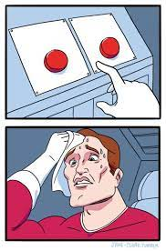
Control over Actions - Agency
How can Intelligence affect Reality? Are there choices?
Free Will - there are choices
All our intuition
All of Ethics/Law - responsibility
Determinism - there is no choice, ‘que sera sera’
Mechanistic world - Descartes - everything is a machine
Laplace’s Demon - position/velocity of all determines future
All of science strives for determinism
Logical vs Biological vs Psychological Determinism
Strict physical laws vs statistical distributions (non-determinism)
https://plato.stanford.edu/entries/freewill/

Slide 58
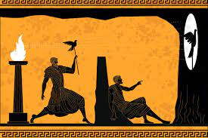
Theories of Truth
Plato’s Cave in ‘The Republic’
The truth is out there - we see a poor version of it
Correspondence - statements match ‘objective’ reality
Coherence - consistent and complete
Constructivist - contingent, created by history and agreement, social convention
Pragmatic - verified/confirmed by practice
https://plato.stanford.edu/entries/truth/

Slide 59
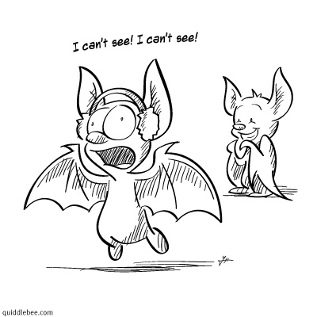
Philosophy of Mind
How do we get from ‘bag of chemicals’ to ‘thinking person’?
What is thought?
Dualism - body and mind are separate
Descartes - ‘cogito ergo sum’
Intuition says thoughts are a different thing entirely from the body
but Princess Catherine - how do they connect if they are separate?
Materialism (Monism) - mind and body are the same
Behaviorism - Skinner - there are only external effects, ignore mental states
Idealism - Berkeley - everything is the mind (but Johnson “I refute it thus”)
Materialism - Hobbes - mind is an ‘epiphenomenon’ of physical processes
Functionalism - implementation doesn’t matter, just inputs and outputs
Jeff Kaplan lectures
What is it like to be a bat?
https://www.goodreads.com/review/show/2690597304

Slide 60
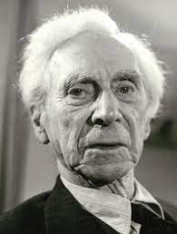
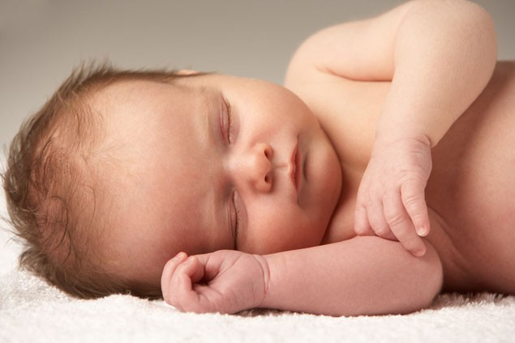
Epistemology - Where does Knowledge come from?
Rationalism - innateness
“reason is the chief source and test of knowledge”
Plato…Descartes, Leibniz, Kant
nature/DNA/what you are born with
Empiricism - environment, learned
Primarily sensory experience - ‘tabula rasa’ = blank slate
Aristotle…Ibn Sina…Locke, Berkeley, Vienna Circle
Problem of induction - Hume, Popper
nurture/experience

Slide 61
Philosophy of Science
Where does scientific knowledge come from?
Logical Positivism
Verificationism - science is things we can verify
Falsification - Popper
Scientific theory/prediction - one that can be disproven by data
Demarcation between Natural Science and Metaphysics
Kuhn - progress is incremental, paradoxical, revolutionary
Normative vs Descriptive
What should be vs what is
Reductionism vs. Holism of scientific areas
“Psychology is Applied Biology is Applied Chemistry is Applied Physics is …”
vs “Each domain has its own fundamental laws”

Slide 62
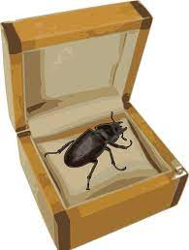
Philosophy of Language
Wittgenstein examples
What is a ‘game’? - ambiguity/vagueness
family resemblance
resolved by context
Beetle in a box
meaning -is- use
Sapir-Whorf hypothesis:
Strong: language determines thought
Weak: language structure influences one’s worldview
Both help you think about language and meaning…
But both are not really borne out by examples, experimentation.

Slide 63
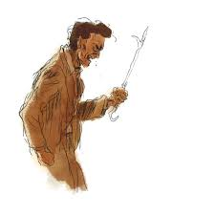
Theories of Ethics
Divine command - from authority (often religious)
Virtue Ethics - Plato, Aristotle - evil is the result of ignorance
Stoicism - peace of mind, self-control
Hedonism - do what gives the most pleasure
Consequentialism - result is key “The ends justify the means”
Utilitarianism - the greatest happiness for the greatest number
Deontological - act from duty, intention is key, Kant’s ‘categorical imperative’
Moral Relativism - it depends on the situation (this is not just ‘anything goes’)
Wait…what does this all have to do with -cognitive- science?
Why is this even here?
Wittgenstein’s Poker

Slide 64
Lessons from Philosophy
Things aren’t black and white
Things have more than one cause/component
Things aren’t simple
Things we’re thinking aren't always said aloud

Slide 65
Cognitive Science for AI
Final Remarks

Slide 66
Primary Areas of Study
Medicine - Neurology, Brain Science
Biology - Animal Behavior, Evolution
Psychology - Cognitive (learning, senses, cognition), Developmental (how babies develop into adults)
Linguistics - Theory, Languages, Psycholinguistics
Philosophy - Epistemology, Philosophy of Mind, Philosophy of Science
Sociology, Anthropology, Economics, Psychiatry/Abnormal Psychology
Computer Science - computational methods/complexity, Artificial Intelligence
Statistics - Regression, Predictive Analytics, Data Science
Mathematics - Logic
Mechanical, Electrical, Industrial Engineering - robotics, control mechanisms, optimization

Slide 67
What Goes Into Intelligence
What you’re born with
Genes/DNA - help build into proteins, cells, tissues, bodies
Biochemical environment for developing a body and brain from those genes
Propensity to speak and think
What you live in
Language environment - what people say and how they respond
Physical environment - enough resources to allow learning
Social environment - relations with others
Interaction of the two

Slide 68
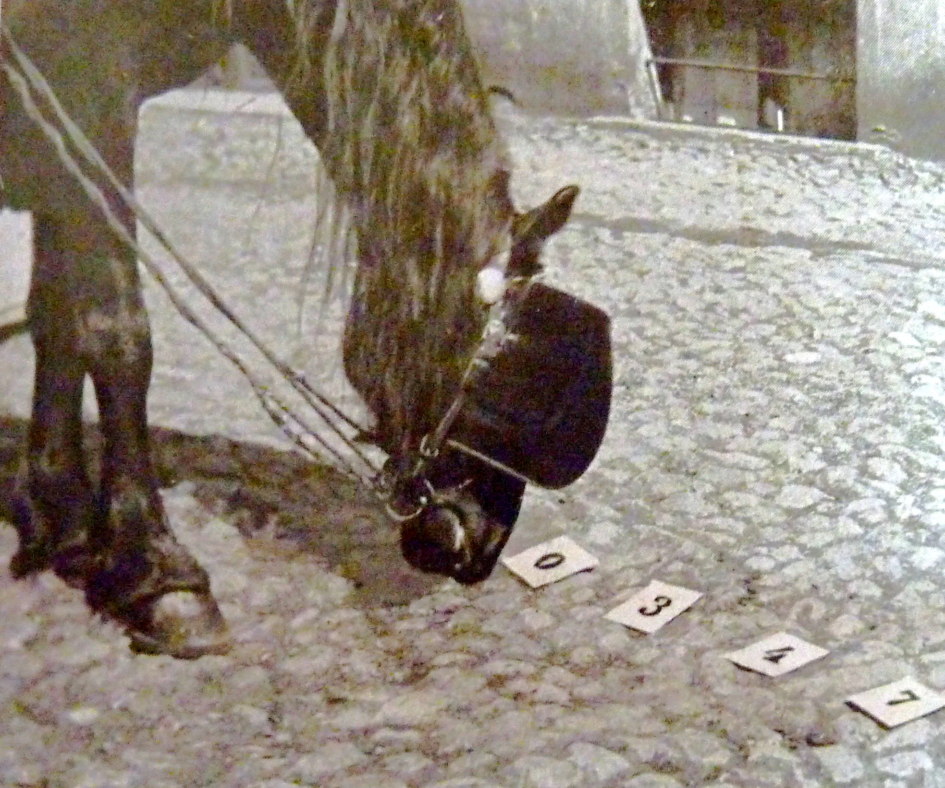
Clever Hans
A horse that does simple arithmetic
"If the eighth day of the month comes on a Tuesday, what is the date of the following Friday?"
Clever Hans would tap out…
11
When experimenter not visible to horse, accuracy drops to random
What exactly is being tested?
Arithmetic? Reading?
Classic experimental errors
Anthropomorphism
Benefit of the doubt
Confirmation bias

Slide 69
Beware of…
Metaphors - “The machine is ‘learning’”-> “The machine is learning”
Anthropomorphization - “the machine acts like a human, it’ll be human in other things.”
Introspection - our own thoughts are biased towards ourselves, everyone else will think the same
Projection - unconsciously, we see in others (and machines) what we see in ourselves
Magical thinking - believing a causal connection with no plausible causal link
Motivated thinking - “I want this so bad to be true…”
Overgeneralization - “The hypothesis works on this small data set, it’ll work everywhere else too”

Slide 70
Meta points
Every bullet point is a world - Wikipedia is a poor man’s explanation. Go further - watch video(s), read a book, talk to people, take a class, etc…
It looks like we know a lot and it feels like there are just known details missing from the bullet points, but there’s so much more that we just don’t know

Slide 71
Cognitive Science for AI
Problems with Vocabulary

Slide 72
Terms in AI - Technical vs Informal
Technical = defined specifically for that purpose
Informal = how people just tend to use it
Intelligence - ability to adapt behavior to change in environment vs clever like a human
Learning - updating coefficients/parameters vs school-like memorization
Thinking/Thought/Belief - a logical predicate vs only vague human-ish meanings
Understanding - only vague human-ish meaning, perceive intention extrapolate and make inferences that generalize “Do you understand?”, common sense
Consciousness - can communicate, awake vs internal monolog, self-awareness
Sentience - can experience feelings/sensations vs aware of themselves like humans
Sapience - ability to reason intelligently vs ability to think like humans
Artificial General Intelligence - can perform more than one thing like a human without specialized training in those things vs can do most anything like a human with human motivations

Slide 73
References
Bio
Psych
CogPsych
Vision
Akmajian, Adrian et al (1995), Linguistics: an introduction to language and communication (fourth edition), Cambridge: MIT Press.
Stanford Encyclopedia of Philosophy https://plato.stanford.edu/index.html

